Slide 1
Welcome to my Presentation

Slide 2
Presentation on Digital Logic Design
Presented By:
Name : Tushar Sarkar
Student ID: 18CSE035
Second Year First Semester
Department of CSE,BSMRSTU,
Gopalganj-8100.

Slide 3
Outline
Question
Converting Excess-3 to BCD(8421)
Converting Table Excess-3 to BCD(8421)
K-Map for A
K-Map for B
K-Map for C
K-Map for D
Minimized Boolean expressions
Logic Diagram

Slide 4
My Question is 4
Design of a combinational circuit that converts excess-3 code to BCD with a 4-bit adder and external gates.

Slide 5
Converting Excess-3 to BCD(8421)
Excess-3 code can be converted back to BCD in the same manner.
Let A,B,C & D be the bits representing the binary numbers, where D is the LSB and A is the MSB.
Let w , x , y & z be the bits representing the gray code of the binary numbers, where z is the LSB and w is the MSB.
The truth table for the conversion is given below.
The X’s mark don’t care conditions.

Slide 6
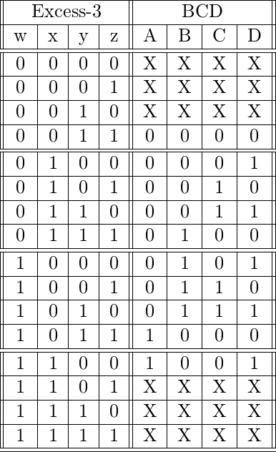
Converting Table Excess-3 to BCD(8421)

Slide 7
K-Map for A
YZ WX | 00 | 01 | 11 | 10
00 | X | X | 0 | X
01 | 0 | 0 | 0 | 0
11 | 1 | X | X | X
10 | 0 | 0 | 1 | 0
WX
WYZ
A = WX + WYZ

Slide 8

K-Map for B
X’Y’
YZ WX | 00 | 01 | 11 | 10
00 | X | X | 0 | X
01 | 0 | 0 | 1 | 0
11 | 0 | X | X | X
10 | 1 | 1 | 0 | 1
XYZ
X’Z’
B = $X^{′}Y^{′}$ + $X^{′}Z^{′}$ + XYZ

Slide 9

K-Map for C
Y’Z
YZ WX | 00 | 01 | 11 | 10
00 | X | X | 0 | X
01 | 0 | 1 | 0 | 1
11 | 0 | X | X | X
10 | 0 | 1 | 0 | 1
YZ’
C = $Y^{′}Z$ + Y $Z^{′}$

Slide 10

K-Map for D
YZ WX | 00 | 01 | 11 | 10
00 | X | X | 0 | X
01 | 1 | 0 | 0 | 1
11 | 1 | X | X | X
10 | 1 | 0 | 0 | 1
Z’
D = $Z^{′}$

Slide 11

Minimized Boolean express
Corresponding minimized Boolean expressions for Excess-3 code bits
A = WX + WYZ
B = $X^{′}Y^{′}$ + $X^{′}Z^{′}$ + XYZ
C = $Y^{′}Z$ + Y $Z^{′}$
D = $Z^{′}$

Slide 12





Logic Diagram
A = WX + WYZ, B = $X^{′}Y^{′}$ + $X^{′}Z^{′}$ + XYZ, C = $Y^{′}Z$ + Y $Z^{′}$, D = $Z^{′}$
W
$$W^{′}$$
X
$$X^{′}$$
y
$$Y^{′}$$
Z
$$Z^{′}$$
A
B
C
D

Slide 13
Thank You

